Slide 1
Windows Tech Series Windows as a Service
Speaker 1
Title
Speaker 2
Title

Slide 2
Agenda
Day | Day 1 Deployment | Day 2 Management | Day 3 Security | Day 4 Windows for CSP
 |  |  |  | Deployment | Management | Security
Synopsis | Module 1 – Introduction | Module 1 – Base System Setup | Module 1 – Analysis Of Common Threats | Module 1 – Windows for SMB Partners
 | Module 2 – Applications & Updates | Module 2 – Configuration | Module 2 – Hardening Windows | Module 2 – Windows Ent. Subscription
 | Module 3 – Windows as a Service (WaaS) | Module 3 – Managing Client Devices | Module 3 – Advanced Threat Protection | Module 3 – Deployment
 | Module 4 – Browsers & Internet Security | Module 4 – Advanced management options I | Module 4 – Information Security (AIP/WIP) | Module 4 – Managing Updates
 | Module 5 – Secure Boot & Device Guard | Module 5 - Advanced management options II | Module 5 – Internet Security

Slide 3
Why Windows as a Service?

Slide 4

What customers are telling us
Passwords are no longer sufficient
My users need access to their apps and data anywhere, anytime
How do I protect my corporate data
We want more transparency and an open dialogue with Microsoft
We need to be adopting new technologies as fast as our customers
No more big deployments
Security of our mobile devices is a top concern
IT Budgets are under pressure. Show us how we can cut IT costs
Too many tools and too much fragmentation

Slide 5
What we hear from you
200+ Days
Median # of days attackers are present before detection
Decade-old PC tech, infrastructure, and processes drive up IT costs and slow business agility.
$146-$188 per device
Cost of keeping user devices up to date and secure
I’m worried about security threats and managing the risk to my business.
$3.5M
Average cost of data breach (15% YoY increase)
$1,930 per PC
Cost of upgrading Windows XP to Windows 7
80% of workers
spend a portion of their time working outside the office
41% of CEOs
Expect digital revenue to double over the next 5 years
My employees need to be productive on every device they use.
We need to capitalize on new business opportunities quickly.
38% of Millennials
feel outdated collaboration tools hinder innovation
47% of existing revenue
considered to be under threat in the next 5 years
Sources: Gartner, Ponemon Institute, IdeaPaint, MIT Center for IS Research

Slide 6

DESIGNED FOR DIGITAL TRANSFORMATION
The most trusted platform
More productive
More personal
The most versatile devices

Slide 7
What is Windows as a Service?

Slide 8

Introducing Windows as a Service
A brand new way of building, deploying, and servicing Windows
Building
Deploying
Servicing
Continual, ongoing development
Deliver new features twice per year
In the open, to enable and encourage feedback
Stay current with simple, automated update process
Unmatched application compatibility
Flexible timelines, methods, tools
Simplified process, to ensure consistency, stability and reliability
Delivered using cumulative updates
Eliminate platform fragmentation for all Windows-based devices

Slide 9
Windows 10: Comparing Servicing Choices
Differentiator | Current Branch | Current Branch for Business | Long Term Servicing Branch
Primary purpose | Pilot Deployments | Broad Deployment | Special Devices
Deployment timeline | Soon after release | About 4 months (or more) after release | Any time during lifecycle
Release frequency | About every six months |  | Approximately every 2-3 years
Updates | All security fixes, moderate bar for other fixes |  | All security fixes, high bar for other fixes
Apps | All in-box apps |  | No in-box apps (except system apps)
Browser | Edge and Internet Explorer 11 |  | Internet Explorer 11
Windows features | All |  | Excludes Cortana, Windows Store
Platform features | Win32, Universal Windows Platform |  | Win32, Universal Windows Platform

Slide 10
Windows as a service: Deploying Windows
Unmatched flexibility and control, depending on needs
Windows Insider Preview Branch
Current Branch
Current Branch for Business
Long Term Servicing Branch
Specific feature and performance feedback
Application compatibility validation
Deploy to appropriate audiences
Test and prepare for broad deployment
Information workers
General population
Specialized systems
Early adopters, initial pilots, IT devices
Deploy for mission critical systems
No need for frequent new features (or any sort of change)
Too expensive for general population
Test machines, small pilots
Benefits from new features
Begins broad deployment
NUMBER OF DEVICES
STAGE
Release

Slide 11
Windows 10: Quality update breakdown
Current Branch / Current Branch for Business | Long Term Servicing Branch

Slide 12
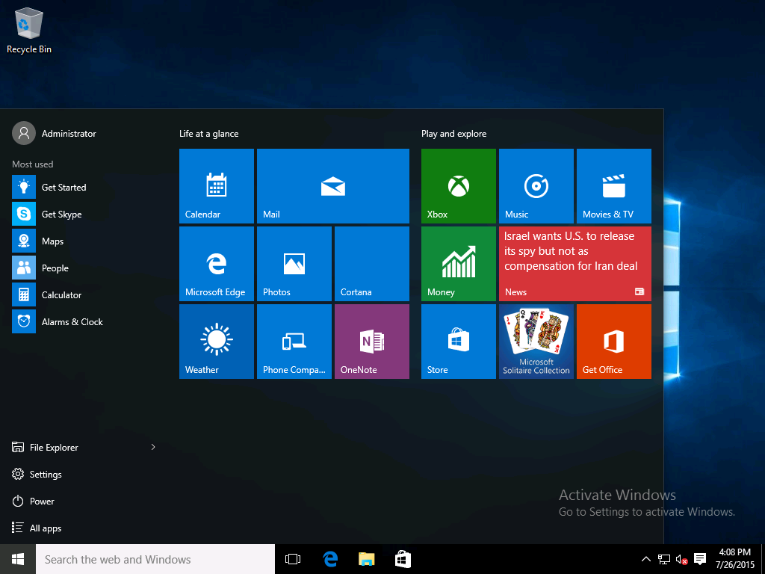
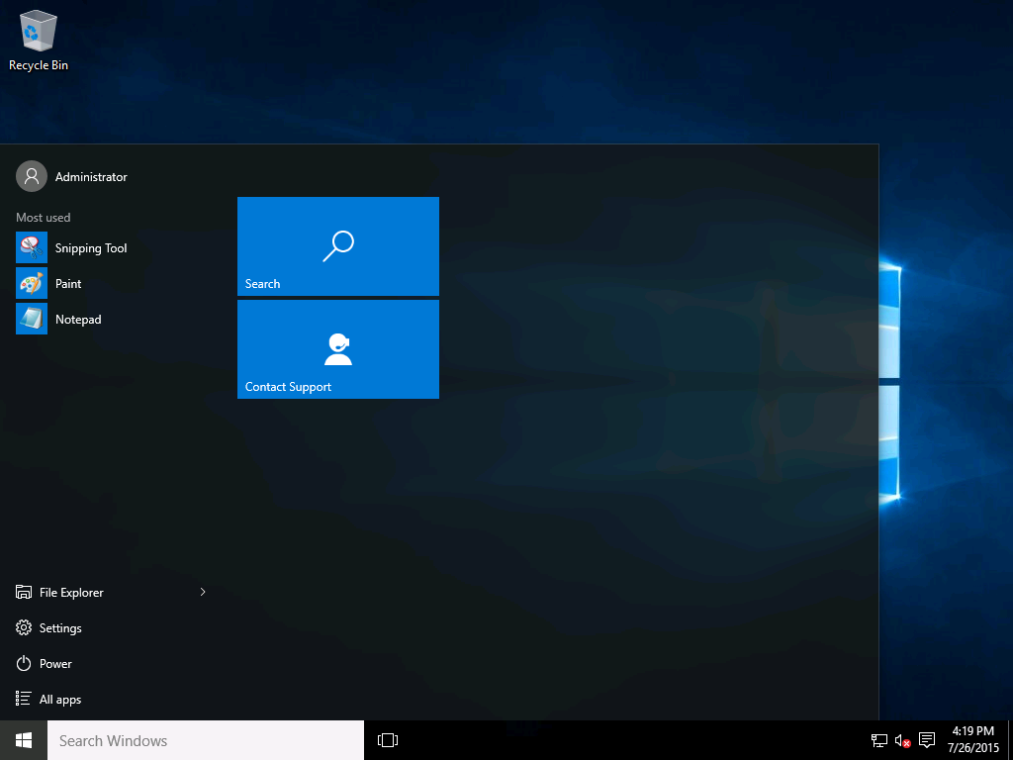
Understand the differences with Windows 10 LTSB
Microsoft Windows 10 Enterprise
(Current Branch, Current Branch for Business)
Microsoft Windows 10 Enterprise 2015 LTSB

Slide 13
Windows as a service: Deploying Windows
Hundreds
of millions
Several Million
10’s of
thousands
Users
Microsoft Insider Preview Branch
Pilot
Engineering builds
Broad Microsoft internal validation
Broad Deployment
Time
Pilot Ring IT
Pilot Ring
QA
Pilot Ring Early Adopters
Broad Deployment Ring I
Broad Deployment Ring II
Broad Deployment Ring III
~6 months
Broad Deployment Ring IV
16 + months
*Conceptual illustration only

Slide 14
Windows as a service: Servicing Windows
With Windows 7 and 8, servicing choices added complexity and cost, increased fragmentation, and reduced quality
What customers are running
What we are testing
 |  |  |  |  |  |  |  |  |  |  |  |  |  |  |  |  |  |  |  |  |  | Y
 |  |  |  |  |  |  |  |  |  |  |  |  |  |  |  |  |  |  |  |  |  | YY
Typical Windows 7 PC: Selectively Patched
Windows 7 Test Lab PC:
Fully Patched

Slide 15
Windows as a service: Servicing Windows
With Windows 10 servicing, consistency and simplicity are paramount
Quality Updates
Feature Updates
A single cumulative update each month
Security fixes, reliability fixes, bug fixes, etc.
Supersedes the previous month’s update
No new features
Try them out with Security Update Validation Program (SUVP), other
Targeting twice per year with new capabilities
Very reliable, with built-in rollback capabilities
Simple deployment using in-place upgrade, driven by existing tools
Try them out with Insider Preview
Changes being considered for older Windows releases as well

Slide 16
Windows as a service: timelines
Windows Insider Preview Branch
New Windows 10 Release
Specific feature and performance feedback
Application compatibility validation
Deploy to pilot audiences
Validate and prepare for broad deployment
Deploy to all audiences, in waves to reduce risk
Evaluate
Pilot
Deploy / Use
Grace
6+ months of active development
~4 months
12+ months
60 days
16+ months to validate, deploy, and use each release
The process repeats…
Evaluate
Pilot
Deploy / Use

Slide 17
Windows as a service: Establishing a rhythm Two releases supported in market
2016
2017
2018
July
Nov
Feb
July
Nov
Feb
July
Nov
Feb
1507
Evaluate
Pilot
Deploy / Use
(done)
4 months
12 months
60 days
1511
Evaluate
Pilot
Deploy / Use
4 months
4 months
~ 20 months
60 days
Summer 2016
(Exact date TBD)
Evaluate
Pilot
Deploy / Use
~8 months
4 months
~16 months
60 days
Example 2017 Release
(Hypothetical date)
Evaluate
Pilot
Deploy / Use
~8 months
~4 months

Slide 18
How to do Windows as a Service

Slide 19
What needs to change

Slide 20
What needs to change
Total costs over three years of WaaS needs to be the same or better than the traditional deployment project cost
Application testing and validation
Infrastructure remediation, upgrades
Deployment itself
All need to be reduced by nearly an order of magnitude
Imaging costs can be eliminated
Customers want proof

Slide 21
Thinking through deployment strategy
1
Configure Insider PCs
Lab or secondary PCs
Enough to explore new features, measure compatibility
2
Identify special PCs
Deploy Windows 10 Enterprise LTSB
Limited numbers (we hope)
3
Recruit volunteers for pilots
Willing participants who will provide feedback
Cover the broadest set of apps and devices possible
4
Divide broad population of PCs
Standard deployment best practice
Focus on risk reduction, minimizing disruption

Slide 22
Planning for WaaS
Windows Insider
Current Branch
Current Branch for Business +0
Current Branch for Business +60
LTSB
Developers
IT Pro Test/Lab
Dev/Test/QA
UAT
IT Pro Primary
Production Pilot
Early Adopters
Production Phase 1 Rollout
(Continues with Phase 2, etc.)
Fixed-Purpose Workstations
Windows Update
Default | Default | “Defer Upgrades” | N/A | Probably Disabled
Disabled | Enabled Current Branch | Enabled CBB - 0 Days | Enabled CBB – 60 Days | N/A
N/A | WSUS-CB Set Affinity/Targeting with GPO* | WSUS-CBB+0 Set Affinity/Targeting with GPO | WSUS-CBB+60 Set Affinity/Targeting with GPO | Updates only
N/A | CB Servicing Plan | CBB+0 Servicing Plan | CBB+60 Servicing Plan | Updates only
Windows Update for Business
WSUS
SCCM
*Specify Intranet Microsoft Update service location and Enable client-side targeting values
Notes:
Talk through the process from the previous slide:
Configure Insider PCs – Determine which computers will be enrolled in Windows Insider. Typically these are self-managed Developer or IT Lab systems.
Identify Special PCs – Determine which systems truly need LTSB. Remind class that LTSB is not usually a good approach to avoid WaaS.
Recruit volunteers for Pilots – These will be the Early Adopters and members of the Production Pilot programs. All will be assigned to CBB+0 groupings.
Divide Broad Population of PCs – These systems will form CBB+ rings. Set days to rational spacing, 30/60/90 days, etc.
Remind class that methods of grouping may vary depending on customer and technology.
For example:
For Windows Update – Manually set the Defer Upgrades setting in the UI for users in CBB.
For Windows Update for Business – A Windows Update for Business GPO assigned to OUs will be the most common approach. Assign computers to OUs based on grouping.
For WSUS – Grouping can still be by OU, and use GPO to set client-side targeting to enroll PCs into WSUS groups (See resource link below.)
For SCCM – Use Collections. Collections can be dynamically built based on filter criteria for maximum flexibility. OU can be one criteria for a filter, as can site, subnet, and many other factors.
Good WSUS Resource here: https://technet.microsoft.com/en-us/itpro/windows/manage/waas-manage-updates-wsus

Slide 23
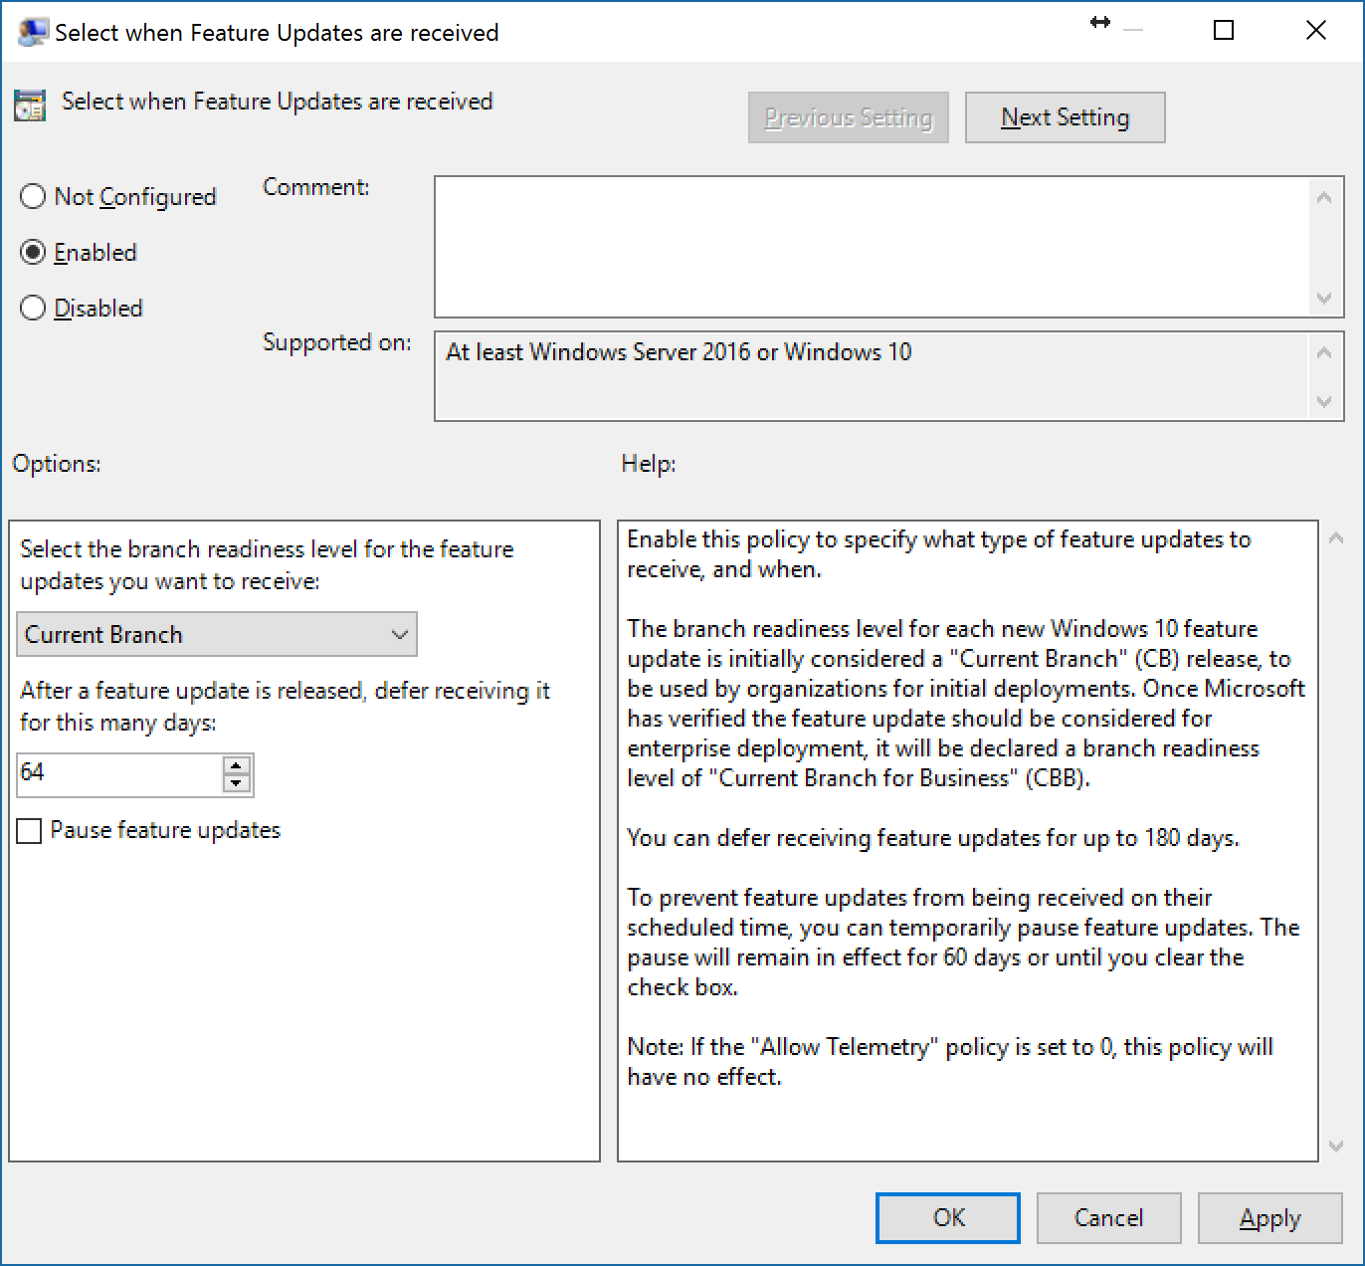
Windows 10: Specifying a preference for what comes next
Devices are not considered CB or CBB
Windows 10 releases transition from one stage to the next
Starts as Current Branch, progresses to Current Branch for Business
Devices specify when they prefer to move to the next feature update
Specify to “Defer” when you want to wait for Current Branch for Business
Each deployment or management tool can implement this idea differently

Slide 24
Implementing a deployment process
1
Validate critical apps and infrastructure
Ensure new release works with business-critical apps, core infrastructure tools
2
Begin pilot deployments
Start with IT, expand to broader volunteer audience, for app and hardware validation
3
React as needed to feedback
A few issues are expected, have a remediation plan in place.
4
Deploy to the broad population
Focus on risk reduction, minimizing disruption through scheduling, segmentation

Slide 25
Compatibility in Windows 10
Outstanding compatibility means a smooth migration from Windows 7 or Windows 8.1
Desktop apps
Web sites
Modern apps
Hardware
Organizations are observing compatibility rates above 99%
High compatibility achieved through:
Minimal changes to Win32 APIs
Insider feedback during development
Telemetry
Internet Explorer 11 included (unchanged) for backwards compatibility
New Microsoft Edge browser for modern HTML5-based web sites
Enterprise Mode features to ensure proper use
High compatibility achieved through:
Validation of Windows Store apps
Insider feedback during development
Telemetry
Significant investments, enhancements in each release
Windows 10 supports all devices capable of running Windows 7 and above
Identical hardware minimum requirements as Windows 7
Strong driver compatibility, with updates delivered as needed through Windows Update

Slide 26
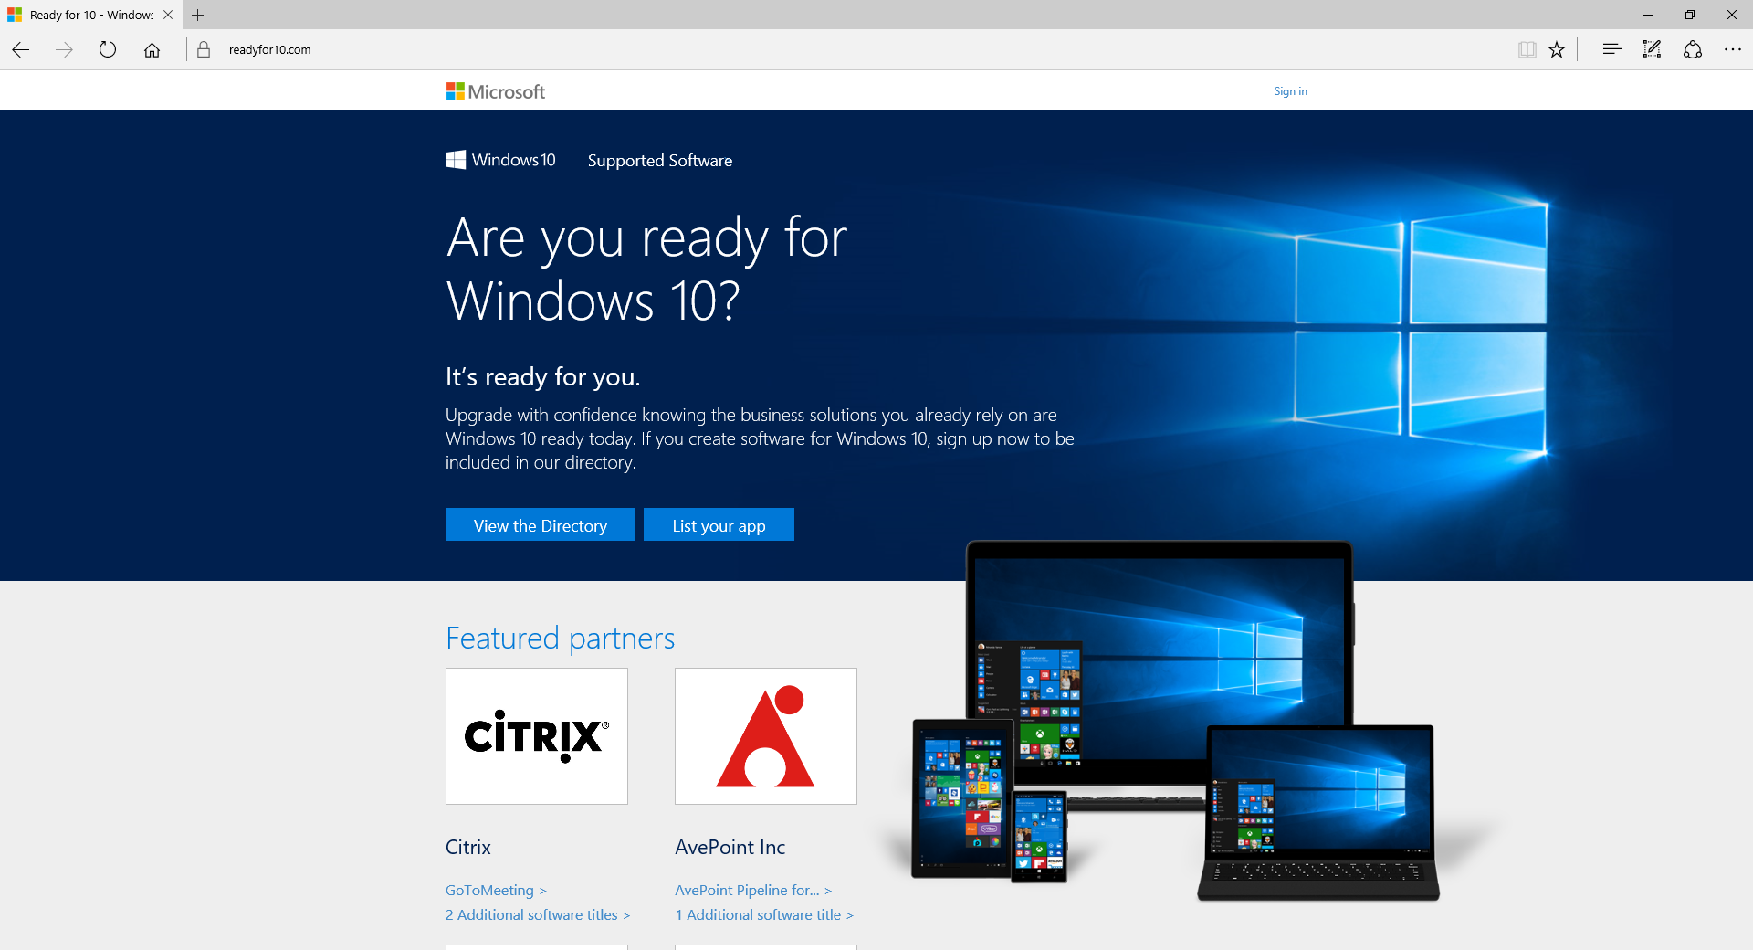
Compatibility in Windows 10
Get links to Windows 10 ISV support statements
http://www.readyforwindows.com
We are actively engaged with ISVs, to ensure full support for Windows as a service

Slide 27
How to validate applications
Create and maintain an app portfolio
Prioritize, identifying critical apps
Validate business-critical apps
Leverage pilots for broader validation
Complete list of apps and web pages used throughout the organization
Business and IT experts identified
IT works with the business to eliminate duplicates, define supported versions
Business critical
Managed
Supported
Unsupported
Blocked
Structured testing, using predefined test plans executed with business and IT experts
Automated if possible
Target small percentage of apps
IT pilot, to gauge infrastructure, environment, and business productivity app readiness
Business pilot, targeting the broadest set of applications possible
Broad deployment using rings, to minimize risk

Slide 28
Windows as a Service Labs Module 01-10: Perform an In-Place upgrade using MDT 2013 Update 2 Module 01-08: Create a Windows 10 reference image for use with WaaS

Slide 29
Distributing content using peer-to-peer
The server and data center are bottlenecks
The edges of the network have more capacity
Using peer-to-peer technologies shifts the traffic to the edges
BranchCache (with WSUS, ConfigMgr)
Delivery Optimization (with WU, WU for Business)
90% or more of the traffic can be shifted
Simple to implement, great for large and small offices
Immediate return on investment
Wireless Access Point
Wireless Access Point
Router
Switches
Router
Switches
Data Center Server
Data Center Server
Without peer-to-peer
With peer-to-peer
Notes:
How Peer to Peer Delivery Optimization works:
Update information is transmitted from Windows Update
Devices begin downloading updates into local cache
As pieces of update appear in cache, other Windows 10 clients can begin downloading from local cache systems
As downloads are completed, they are validated against Windows Update information from Microsoft before they are applied
In reality, getting updates from multiple sources ensures integrity better than a single source as it is much harder to spoof multiple sources.
Behavior can be controlled through Group Policy
Prevent Internet – Client will not use sources that are not local Intranet
Prevent All – Client will only use Windows Update source (Microsoft or WSUS/Config Manager)

Slide 30

Identifying a tool to use
Windows Update for Business
Windows Server Update Services
System Center Configuration Manager
Windows Update
Cloud
Upgrades installed as they are released (subject to throttling)
Delivery optimization for peer-to-peer distribution
Only option for Windows 10 Home
Cloud
Upgrades can be deferred
Builds on top of Windows Update
Uses Windows Update for content
On-Prem
Upgrades are deployed when you approve them
Content distributed from WSUS servers
Requires KB3095113
BranchCache to reduce bandwidth
On-Prem
Choice of task sequence-based upgrades or (with vNext) software update capabilities
Content distributed from ConfigMgr DPs
BranchCache to reduce bandwidth

Slide 31
Windows Update for Business
Policy setting example in Windows Update for Business
Policies implemented in Windows 10 1511, effective for the next feature upgrade deployment
Windows 10 Enterprise SKU is published to Windows Update (MAK and KMS)
Capabilities
Time to test and validate feature updates
Summer ‘15
Ability to create internal deployment groups
Fall ‘15
Active Hours maintenance windows
Summer ‘16
Peer to peer delivery to optimize for bandwidth
Summer ‘15
Integration with your existing tools like System Center
Coming soon
Access to Current branch and Current branch for Business
Summer ‘15
New policies for Windows 10 1607
Notes:
The WU client goes through a process to see if the new Anniversary Update GPO keys are set and if not goes back to the old keys. See here https://microsoft.sharepoint.com/teams/Windows10CSSReady/_layouts/15/WopiFrame.aspx?sourcedoc={0E2E0AC1-7901-4B6B-A3D4-677C1934F881}&file=78381_Win10_v1607_Deployment.docx&action=default

Slide 32
Demo
Windows Update for Business

Slide 33
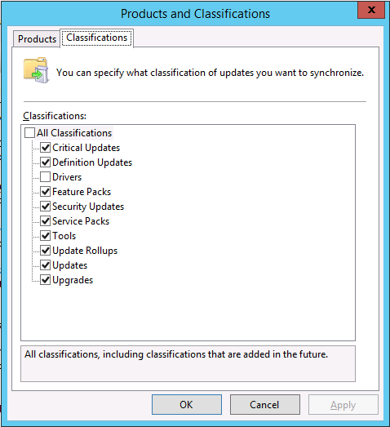
Windows Server Update Services
Enabling upgrades
Updated to support Windows 10 feature upgrades, including upgrades from downlevel OSes
Requires WSUS 4.0 (Windows Server 2012 or above) with KB3095113
See http://blogs.technet.com/b/wsus/archive/2015/12/04/important-update-for-wsus-4-0-kb-3095113.aspx for an important note

Slide 34
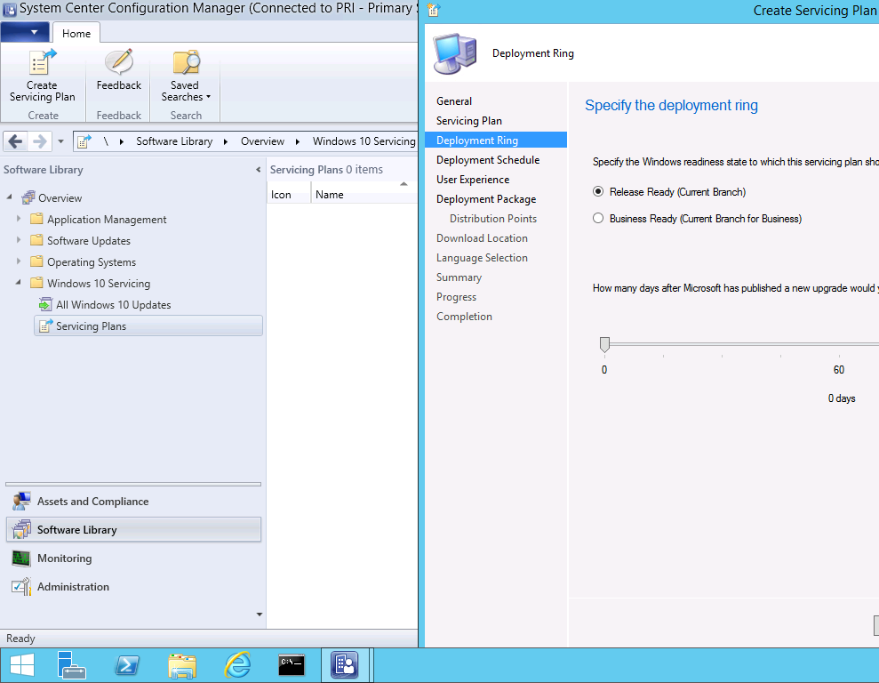
System Center Configuration Manager
Servicing Plans
System Center Configuration Manager 1602 or later needed to support Windows 10 1607
Requires WSUS 4.0 (Windows Server 2012 or above) with KB3095113
Windows 10 Servicing Plans provide automation

Slide 35

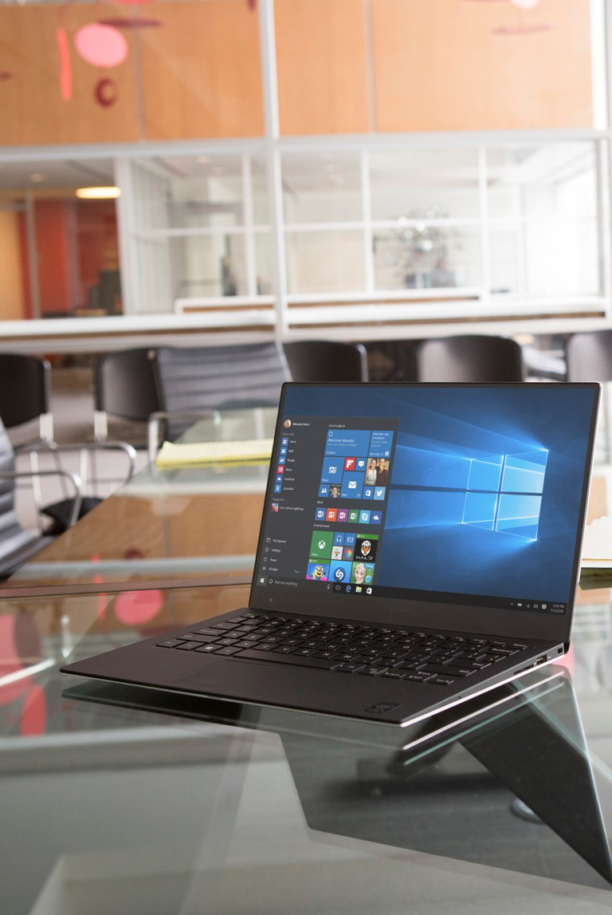
Call to action
Understand that Windows as a service requires some changes
Get customers to pilot Windows 10
Implement a Windows 10 servicing process

